Slide 1
Emotion Recognition From Face Images
Team : 18
Team Members:
Padam Prakash
Prashant Kumar
Zakir Ali

Slide 2
Introduction
Facial expressions recognition system has received significant attention among researchers in recent decades mainly because of it is diversified applications, such as
Human computer interactions
Surveillance
Treatment of mentally retarded patients and
Lie detection.

Slide 3
Various Emotions
We have worked on Seven basic expressions, namely,
Happiness
Sadness
Disgust
Anger
Surprise
Fear and
Neutral

Slide 4
About our Project
1-Collection of datasets
We have used two datasets:
1. ‘FER2013’ from Kaggle
2. ‘CK+’ (Cohn-Kanade)

Slide 5






Different Images from datasets

Slide 6
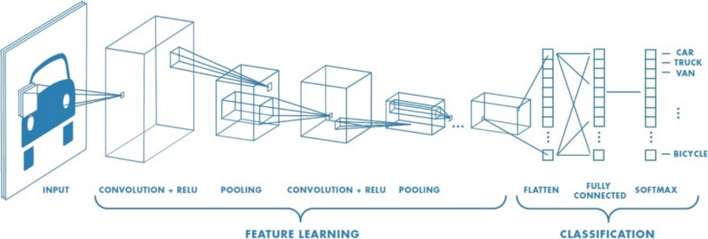
About Model
2-Training and Testing of model
We used ‘CNN’ Architecture to train and Test our model.

Slide 7
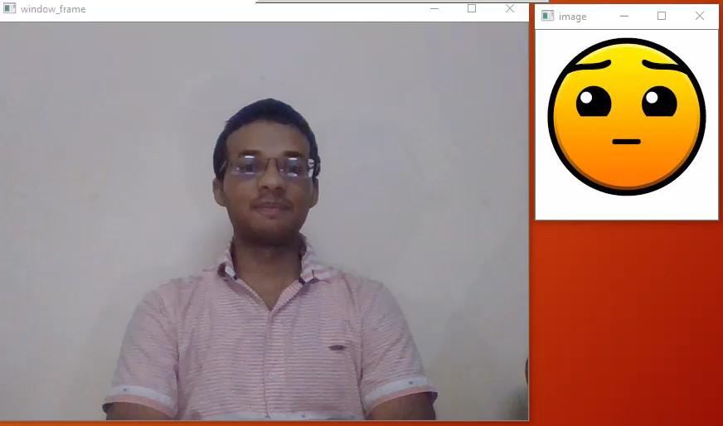

Slide 8
Live Model Testing
We have used OpenCV for live model testing.
The output is emotion of captured image on screen and corresponding emoji is shown on the screen too .

Slide 9
Challenges Faced
There is no Landmark Distinction between the different Emotions on the face. Emotions like fear and surprise are quite similar.
There are lot of Complexity and Variability among Images of Human face.
CNN Requires Huge data.

Slide 10
References
1. Facial Emotion Recognition using Deep Convolutional Networks
https://ieeexplore.ieee.org/document/8324974
2.Automatic Facial Expression Recognition System Using Deep Network-Based Data Fusion
https://ieeexplore.ieee.org/abstract/document/7747479
3. Emotion recognition from geometric facial features using self- organizing map
https://www.sciencedirect.com/science/article/pii/S0031320313004202

